Slide 1

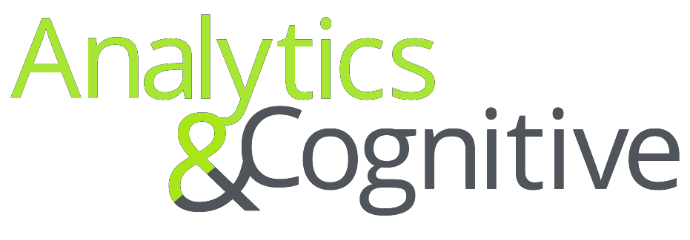
Azure analytics
Center of Excellence
DFTEs – October 2021
Reach out: US India Consulting A&C Azure CoP (US) usindiaconsultingacazurecop@deloitte.com

Slide 2

Microsoft Azure Cloud DFTEs
Reusable cloud based DFTEs developed by Deloitte for rapid and quality deliverables on Microsoft Azure
# | Asset | Owner | Current Status | Asset Location | Projects which leveraged asset | Comments
1 | Azure Ingester - Automated ingestion Framework built with latest and best of breed Azure components | Rahul Kochhar, Girish Bommisetty, Ritika Bhatia | Published | DFTE | Nestle | Version 2 Published
2 | Azure Deployer - Automated deployment tool kit built with latest Azure components. Also enables validation & comparison of SQL DW data models across different Cloud environments | Kanishk Malik, Bharath B. | Published | DFTE | Nestle | Version 2 in progress, Planned by December 2021
3 | Azure PaaS EnvMaker - Script based configurable framework for automated PaaS based environment set up | Bharath B., Krishna V. | Published | DFTE | Nestle
4 | Azure Runner: Logic app-based solution to support automated email alert and pipeline refresh | Kanishk Malik, Anuj Sharma | Published | DFTE | Nestle
5 | Azure DQ and CDC Rule Engine - Library of pluggable code and logic to support SCD/CDC functionality and Common DQ logic | Hemanth Pissay, Anuj Sharma | Published | DFTE | Nestle
6 | Azure AAS Utilities- AAS Automation scripts (AAS Backup-Restore-Process Utility, AS Memory Manager, Partition Builder) | Hitesh Bhatia, Vipul Gupta, Rahul Kochhar | Published | DFTE | Diageo, Nestle
7 | Power BI documentation Toolkit – Document BI reports with details of lineage items, filters and other aspects used as design documentation | Rishabh Sahni | Published | DFTE | Caterpillar
8 | ADF Extractor – Document Azure data factory pipeline code which can be used as technical specification, impact analysis, code review. | Divya Shah, Saurabh Doiphode | Published | DFTE | Sazerac
9 | AAS Tabular Model Build and Documentation Toolkit: A .NET utility to extract SSAS Tabular models metadata and document them. Provides capability to develop models dynamically and add incremental changes to existing models | Divya Shah | Published | DFTE | HPI, Unilever
10 | Azure Data Lake Visibility Assistant - Chatbot based framework to discover the available data and its staleness in Azure data lake | Kanishk Malik, Karanbir Virk | Published | DFTE | Nestle
11 | Azure Automated Web File Downloader - Automated process workflow on extracting the files which resides into any web page into Azure Data Lake | Kanishk Malik, Anuj Sharma | Published | DFTE | Nestle
12 | Azure AS-elator - Performance Test utility (Log Analytics) for AAS based semantic layer model and frontend Power BI dashboards | Tilak Dash, Megha Jain, Karanvir Virk | Published | DFTE | Diageo, Nestle

Slide 3
Microsoft Azure Cloud DFTEs - Backlog
# | Asset | New / Enhancement | Team working on this DFTE | Work Status | Comments
1 | Azure Ingester Version 3 enhancements: DQ Check Addition: Expected number of columns in a record in file Annotation Addition so it is easier to debug the pipeline failures | Enhancement | Ritika Bhatia | Completed in client environment (Nestle) which leveraged this asset. Yet to make these code changes in AI boldplay environment and corresponding documentation updates due to capacity crunch
2 | Azure Deployer enhancements: Data Factory automated Incremental Deployment: Currently there is a manual step if we have to deploy specific pipelines. This enhancement will check the dependencies and create ARM template specific to the pipelines that the team needs to migrate | Enhancement | Nanda Kishore | Build complete, Testing In Progress in client environment (Nestle). Yet to make these code changes in AI boldplay environment and corresponding documentation updates due to capacity crunch
3 | Azure PaaS EnvMaker enhancements: Terraform based Environment Provision | Enhancement | Manu Saxena | Planned by December 2021
4 | Azure Monitoring Assistant– Perform ADF real time monitoring with built in analytics based on historical trend | New | Shivansh Pandey Anuj Sharma | DFTE Planned by December 2021
5 | Azure Encrypter - Spark based Ingestion framework which encrypts the data at rest / in transit | New | Anuj Sharma Avishek Chatterjee | DFTE Planned by October 2021
6 | <Appliance Offload Asset 1> - Python based utility to convert Informatica ETL mappings to ADF pipelines | New | Pradeep Penumarthy Samyuktha Hari Sushmita Arushi Gupta | DFTE Planned by December 2021
7 | <Appliance Offload Asset 2> - Python based utility to migrate data models and structures from a variety of RDBMS to Azure Synapse and SQL DB | New | Pradeep Penumarthy Samyuktha Hari Sushmita Arushi Gupta | DFTE Planned by December 2021

Slide 4
Azure DFTEs Mapped to Priority Campaigns
# | Digital FTE | Functionality Support | Azure Campaigns
 |  |  | Appliance Offload | BI Modernization | Accelerate AI/ML | Data in Motion
1 | Azure Ingestor | An Azure Data Factory integrated data ingestion framework, parameterized for automated pipeline build & pre-integrated with Audit, Balance, & Control Framework. (This DFTE will be leveraged only for Audit, Balance, & Control framework)
2 | Azure Deployer | Provides standardized optimal way of code management, code versioning and automated deployment on Azure platform through AzureDevOps pipeline
3 | Azure PaaS EnvMaker | Azure PaaS (Platform as a Service) EnvMaker is a script based configurable framework for automated PaaS Env. setup. This utility can be leveraged as plug and play solution in any client Env..
4 | Azure Runner | Logic app-based solution to support automated email alert and pipeline refresh
5 | Azure CDC & DQ | Library of pluggable code and logic to support SCD/CDC functionality and Common DQ logic, to augment rapid development and data ingestion
6 | AAS Utilities | AAS Automation scripts (AAS Backup-Restore-Process Utility, AS Memory Manager, Partition Builder)
7 | Power BI documentation Toolkit | Document BI reports with details of lineage items, filters and other aspects used as design documentation
8 | ADF Extractor | Document Azure data factory pipeline code which can be used as technical specification, impact analysis, code review
9 | AAS Tabular Model Automation Toolkit | Logic app-based solution to support automated email alert and pipeline refresh
10 | Azure Data Lake Visibility Assistant | Chatbot based framework to discover the available data and its staleness in Azure data lake
11 | Azure Web File Downloader | Azure Web File Downloader empowers businesses to craft automated process workflow on extracting the files which resides into any web page/application into Azure Data Lake. This took is reusable and Plug in Play app.
12 | Azure AS-elator | A load testing utility that gauges the performance of Azure Analysis Services Models by executing a set of queries for a list of concurrent users
13 | Azure Monitoring Assistant | Perform ADF real time monitoring with built in analytics based on historical trend
14 | Azure Encrypter | Spark based Ingestion framework which encrypts the data when in transit

Slide 5
Non-Azure DFTEs Mapped to Priority Campaigns
# | Digital FTE | Functionality Support | Azure Campaigns
 |  |  | Appliance Offload | BI Modernization | Accelerate AI/ML | Data in Motion
1 | UNDIAL RE | A reverse engineering tool capable of creating source to target mapping, transformation rules, & data lineage in data migration work
2 | D-Ingest | Collection of reusable metadata driven Apache NiFi processors to assemble data ingestion pipelines for both structured and semi-structured files, perform configurable file validations and route data to HDFS with/without Kafka
3 | ADLFx | ADLFX is a data & analytics framework that provides capabilities to provide scalability and flexibility with data processing, provisioning and end user self service capabilities to rapidly stand-up data lakes​
4 | AutoScript | Python based testing framework which facilitates parallel testing for large number of objects and test scenario
5 | Dmask | D-Mask formerly known as DMart, provides capability to not only camouflage but also replicate data volumes with a wide variety of values. It can mask and generate millions of records maintaining referential integrity between various entities
6 | Snowflake Dadmin | Automating Snowflake user setup and migration
7 | Schemanator | Automates the conversion of source RDBMS metadata to Hive/HBase table objects, expediting creation of Hive/HBase Schema in platform modernization
8 | PyBOT | PYBOT is a PySpark code generation asset which can be deployed on any scalable Spark based Cloud/On-Prem platform

Slide 6




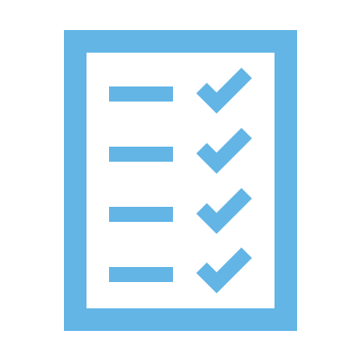
DFTEs / Accelerators
Reusable cloud-based Tools, Accelerators and Utilities developed by Deloitte for rapid and quality deliverables
DFTE
Definition
Features
Benefits
Use Cases
Framework is a collection of reusable metadata driven engines.
It enables seamless ingestion of various source types in Azure using ADF
Batch data integration
Metadata driven
Data validation, auditing and monitoring
Leverage Azure connectors for better connectivity
Data ingestion at speed and scale
Reduced overall development time
Error logging and notifications
Defect free variables
ABC framework
Ingestion framework
Azure Ingester
A framework that defines set of dev, testing and deploy rules for Azure application development.
Provides a standardized and optimized way of code management, code versioning and automated deployment
Deployment automation
Support for Agile methodology
Automated email approval process for Code Merge
Notification alert when a pull or merge is requested
Reduced project timelines
Automated notification
Improved operational efficiency
Controlled code pull and merge
Reduced errors due to lesser human intervention
Automated CI/CD process using Azure DevOps
Incremental features release management
Agile process management for code versioning
Azure Deployer

Slide 7

DFTEs / Accelerators
Reusable cloud-based Tools, Accelerators and Utilities developed by Deloitte for rapid and quality deliverables
DFTE
Definition
Features
Benefits
Use Cases
An automated tool for Azure based PaaS Environment set up which fastens the resources creation in Azure Environment.
It also brings up multiple environments with predefined set up of Azure resources in a short interval of time.
Reduces manual efforts significantly for multiple environment provisions
Saves environment set up time and rework
Reduces processing timeline by 85%
Plug in play solution, can be configured in any Azure based client environment
Save efforts in environment set up and cost of hiring Human resources
Azure Infrastructure Provision
Multiple environments like QA/Dev/Prod setup
Azure PaaS EnvMaker
Solution for most common 5 scenarios in a BI project that can be solved effectively via Logic Apps
Automates the build of the logic apps with parametrized framework
ARM templates that can be deployed in any environment to build the logic apps
Same templates can be used to migrate the logic apps across different environments
Process Efficiency – Accelerates the development process as the DFTE takes care of design process to solve common use cases
Consistency – Ensure code is consistent with standards
Rapid development– Logic apps can be deployed in any environment using ARM templates
Email Functionality (Attachment enabled)
AAS Refresh Functionality
File based ADF trigger Functionality
Power BI Dataset refresh
Scrum Board Monitor
Azure Runner

Slide 8
DFTEs / Accelerators
Reusable cloud-based Tools, Accelerators and Utilities developed by Deloitte for rapid and quality deliverables
DFTE
Definition
Features
Benefits
Use Cases
A library of pluggable code and logic to support SCD functionality and Common DQ logic
This Code leverages SCD and Data Quality Assessment which are in demand for AI/Data Mining and Data warehousing engagement's
Significant reduction in manual efforts and uncertainty in the server load management
Metadata driven and configurable for similar scenarios and Scalable
Reusable - Subroutine (Code) can accommodate any Input Schema
Can reduce manual effort by 70% to 80% given in core Design, Code, Testing, Deployment and Maintenance phase of a project
Resource Utilization
Data ingestion at speed and scale
Improved operational efficiency
Incremental Data Consumption using databricks
Robust DQ Framework
Azure DQ & CDC Rule Engine
Optimized and automated utility for Azure Analysis services to create enterprise-grade data models in the cloud
Azure AAS Utility is an Automated framework for automating the process of scheduled refresh of AAS Model objects
Auto Back up and Restore and Auto Scale up/down of Azure Analysis services based on the Business hours.
Automatic scale up and down
Automated model refresh with input parameters using secure data gateway
Easily restore and backup up on request
Cross region replication gives the redundancy of data and faster query response, if user base is across different regions
Resource Optimization - Scale resources to match your business needs
Process Efficiency – Accelerates query response for multiple region user base by functionality of cross region replication
Optimized backup – Based on business hours auto backup and restores auto scale of Azure analytics services
Enterprise grade data models creation
Automate AAS model objects refresh process
Auto Back up & restore
Resource optimization
AAS Utilities

Slide 9
DFTEs / Accelerators
Reusable cloud-based Tools, Accelerators and Utilities developed by Deloitte for rapid and quality deliverables
DFTE
Definition
Features
Benefits
Use Cases
Allows to create power BI reports mapping for future enhancement analysis, impacts due to change
Automate the documentation of reports mapping with low level details.
Ability to validate power BI source for logic and calculations
Simple UI based python utility which supports path details of the reports to document the details by reading the pbix file
Reverse engineer old/unused power BI reports with mapping information
Process Efficiency – Accelerates the reports mapping and lineage documentation
Lineage Reconciler – Data lineage from layout to source table can be identified along with the connection details, filters and transformations applied
Rapid development– Correcting multiple reports dashboards with any change quickly
Design Documentation
Reverse Engineering
Code Review
Power BI Documentation ToolKit
Allows to create data driven workflows for data movement and transformation
Automate the documentation of pipelines with low level details.
Ability to apply mass corrections on multiple ADF pipelines
Simple UI based python utility which supports input as ARM template with multiple ADF pipeline as well as single pipeline to document the details by reading the json code behind
Reverse engineer old/unused ADF pipelines with the activity level detailed information
Process Efficiency – Accelerates the review process
Consistency – Ensure code is consistent with standards
Rapid development– Correcting multiple ADF pipelines with any change quickly
ADF Documentation
Reverse Engineering
Code Review
ADF Extractor

Slide 10
DFTEs / Accelerators
Reusable cloud-based Tools, Accelerators and Utilities developed by Deloitte for rapid and quality deliverables
DFTE
Definition
Features
Benefits
Use Cases
SSAS Tabular Model Build, and Documentation Automation Tool is a C#.NET utility which leverages the Tabular Object Model Library (TOM) for documentation and building the various components of SSAS Tabular Model.
Multiple models can be built dynamically with simple input parameters requiring minimal technical knowledge
Minimize manual effort for development activities and deliver with good quality and on time
Recurrent changes on the code can be documented easily with accuracy
Improved Code Quality
Dynamic Model Build
Increased Productivity
Flexibility to Address Enhancements
Azure Analysis Services Code review
AAS Documentation
AAS Incremental updates
AAS Tabular Model Automation Toolkit
Data Lake Visibility Assistant is a chatbot which helps users to get information about metadata of datasets present in the data lake just by sending a message.
Users don’t need to navigate through storage explorers or data catalogues to find out answers to their queries related to metadata
Natural Language Processing
Just in time response
User Authentication & Authorization
Scalable and Secure
Ease to Configure
Improved Productivity - Answer to queries just a message away
Data Lake Self Service - User don’t have to reach out to Ops to find out answers to basic questions
Service Excellence - Consistent and on-time response to the queries related to datasets metadata
Azure Data Lake Exploration & Know your Data
Azure Data Lake Visibility Assistant

Slide 11
DFTEs / Accelerators
Reusable cloud-based Tools, Accelerators and Utilities developed by Deloitte for rapid and quality deliverables
DFTE
Definition
Features
Benefits
Use Cases
Crafts automated process workflow on extracting the files which resides into any web page/application to Data Lake
Python based App
Can accommodate any use case and it is very user friendly & increase resource utilization
Written-on Python which uses Chrome Driver and packaged it into Docker Image
Scalable Data Ingestion
Defect Free Deliverable
Process Efficiency – Significant time and cost savings
Effort Reduction - Reduces manual development efforts
Provides Flexibility - Can be easily customized as per different business needs.
Automatic Reports Download from web Portals
Consumer industry has good use of this as many retailers provide the information directly from their web portals
Azure Automated Web File Downloader
A load testing utility that gauges the performance of AAS models by executing the set of queries for list of concurrent users.
It generate details dashboard that display the performance metrics.
Highly configurable
Robust and Reliable
Reduce time taken for testing AAS Models
Highly Productive
Reduce Testing time by 75%
Reduced performance bottlenecks and enhance performance
Details Report of performance metrics for concurrent users
Performances Testing of AAS
Azure AS-Elator

Slide 12
DFTEs / Accelerators
Reusable cloud based Tools, Accelerators and Utilities developed by Deloitte for rapid and quality deliverables
DFTE
Definition
Features
Benefits
Use Cases
Customized Library on Pyspark which Encrypts the PII Data at high scale. Utility can encrypt the columns as well as Flat file.
It also decrypts data for authorized users at run time dynamically and block for unauthorized users.
Highly configurable
Securing PII Data
Reduce Build Effort time by 60%
Plug in play solution, can be configured in any Azure based client environment
Error logging and notifications
Data Encryption in-flight or at rest
Azure Encryption

Slide 13
DFTEs / Accelerators
Reusable cloud-based Tools, Accelerators and Utilities developed by Deloitte for rapid and quality deliverables
DFTE
Definition
Features
Benefits
Use Cases
Custom Reporting Real time Solution for monitoring and logging all the ADF Jobs. Solution would be single Source of truth to analyze the failed pipelines and It also highlights long running jobs which might be exhausting the existing resource
Azure Monitoring Assistant
IDEATION

Slide 14
Appendix

Slide 15
Important Links:
Description | Link | Comments
Azure CoP DL | usacazurecop@deloitte.com | Can be used to reach out to Azure CoP
Azure CoP Teams Channel | A&C Azure CoP Teams Channel | Please join to collaborate
DFTE Microsite | https://consulting.deloitteresources.com/op/strategy_analytics_ma/analytics_cognitive/Pages/anc-digital-FTEs.aspx | Maintained by usdigitalfte@deloitte.com team and can be reached out in case of any questions
DFTE Selector Document (Has DFTE Resume and demo video etc. ) | https://www.km.deloitteresources.com/sites/live/consulting/_layouts/DTTS.DR.KAMDocumentForms/KAMDisplay.aspx?List=513ae4d5-443f-4bc1-9f25-8f68dc5aa0c0&ID=8667206 | Maintained by usdigitalfte@deloitte.com team and can be reached out in case of any questions
DFTE Deployment Tracker (To check for Adoption) | https://amedeloitte.sharepoint.com/:x:/s/DigitalFTE925/EY3ct1H5wVtNiwQh6TDscwkBe10M13bZ2R9n3aZCBWZqmA?e=sTqpZQ | Maintained by usdigitalfte@deloitte.com team and can be reached out in case of any questions

Slide 16
A&C Data Modernization & Analytics Bundle: SKU and BOM Details
SKU #: A&C- Appliance Offload to Azure (incl Snowflake) | OP/Offering: S&A/A&C | PMD Sponsor: Ashish Verma, Jignesh Barai | PDI Short Description: Curated DFTEs for Appliance offload programs to Azure platform (including Snowflake) and accelerate time to value through repeatable automation and standardization. | 18 DFTEs included in bundle
Bill of Material (BOM):
Stage | DFTE Name | Description | SDLC Applicability | Infrastructure Needs
Data Ingestion, Engineering & Processing | Azure Ingestor | Collection of reusable metadata driven engine that automates data ingestion for structured files, perform configurable data quality validations and ingest to data lake using data bricks | Implement | Azure Env. in place, Azure Data Factory, a Database (Azure Synapse / SQL DB / any other data warehouse)
 | UNDIAL RE | A reverse engineering tool capable of creating data lineage from code. It generates source to target mappings including the transformations and can visualize the entire lineage. | Design | Opensource (Python)
 | Azure Deployer | Automated Code Deployer was created to automate the process of deployment of project code from GIT to various platforms. | Implement, Operate | Azure Env. & Azure DevOps Access
 | Azure AS-Elator | Performance Test utility (Log Analytics) for AAS based semantic layer model and frontend Power BI dashboards | Testing | Azure Env., Azure Analysis Services, .NET Framework setup (Open source)
 | AAS Utilities | AAS Automation scripts (AAS Backup-Restore-Process Utility, AS Memory Manager, Partition Builder) | Implement | Azure Env. & Azure Analysis Services
 | Azure Log Analytics | Perform dynamic analytics by reading log files from Azure services | Implement | Azure Env., Azure Log Analytics Service
 | AutoScript | Parallel testing for large number of objects and test scenarios in a big data Env. by auto generation and execution of test scripts. | Test | Opensource (Python)
 | Schemanator | Automates the conversion of source RDBMS metadata to Hive/HBase table objects, expediting creation of Hive/HBase Schema in platform modernization | Implement | Opensource (Python)
 | D-Ingest | Collection of reusable metadata driven Apache NiFi processors to assemble data ingestion pipelines for both structured and semi-structured files, perform configurable file validations and route data to HDFS with/without Kafka | Implement | Opensource (Apache Nifi & Kafka)
 | AAS Tabular Model Automation Toolkit | Tabular model/Azure analysis services is a state-of-art SQL Server Analysis Services databases which acts as a cross between a SQL Server relational database and an SSAS multidimensional cube. They are known to be fast and efficient in delivering self-service business intelligence to many applications | Implement | Azure Env.
 | Azure PaaS EnvMaker | Azure PaaS (Platform as a Service) EnvMaker is a script based configurable framework for automated PaaS Env. setup. This utility can be leveraged as plug and play solution in any client Env.. | Implement | Azure Env.
Governance, Metadata & Quality | Azure DQ & CDC Rules Engine | Library of pluggable code and logic to support SCD/CDC functionality and Common DQ logic | Operate | Azure Env.
 | ADLF | Augmented Data Lake Framework (ADLF) is a data & analytics framework that provides capabilities to provide scalability and flexibility with data processing, provisioning and end user self service capabilities to rapidly stand-up data lakes. | Implement | Opensource (Pyspark)
 | ABC Framework | A tool-agnostic framework to capture job execution information with Job statistics, rejected & error records | Implement | Opensource (JAVA)
 | Dmask | Masks and generates millions of records maintaining referential integrity between various entities | Test | Opensource (JAVA)
 | ADF Extractor | Document Azure data factory pipeline code which can be used as technical specification, impact analysis, code review | Implement | Azure Data Factory & Microsoft Excel
Monitoring | Azure Runner | Logic app-based solution to support automated email alert and pipeline refresh | Operate | Azure Logic Apps
Snowflake | Snowflake Dadmin | Automating Snowflake user setup and migration | Implement | Snowflake License
Including up to 5 hours of demo and deployment support from DFTE Support team. No customizations included.
SKU Transfer Charge $ 20 K per bundle per year

Slide 17
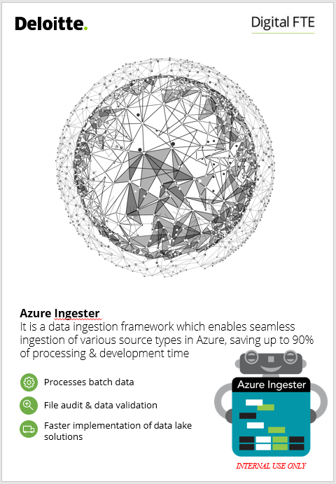
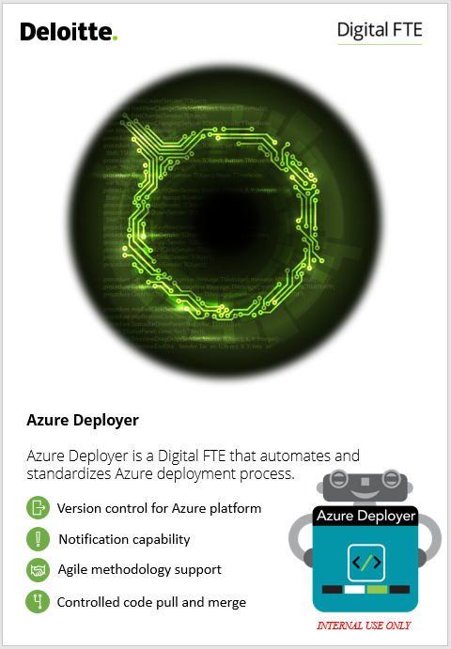
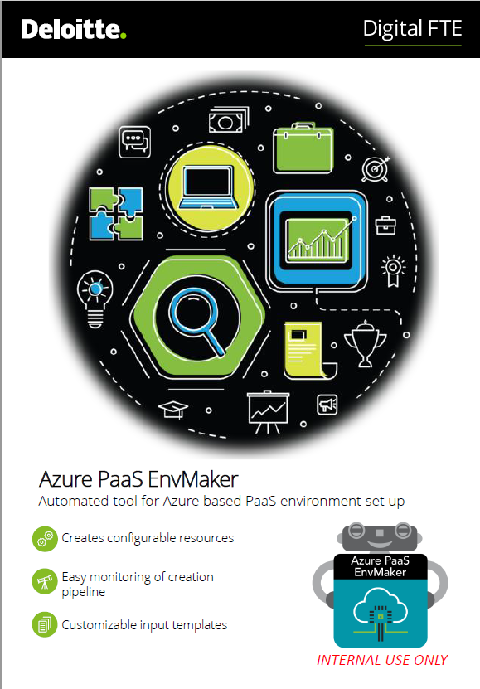
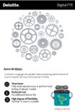
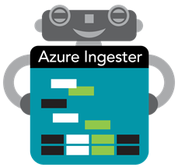
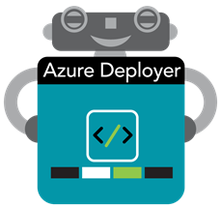
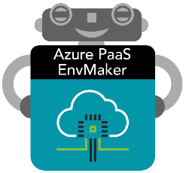

DFTE Logos
Azure Ingestor
Azure Deployer
Azure PaaS EnvMaker
Azure AS-elator

